Slide 1

Machine Learning-Based Metagenomic Analysis of Soil Microbes
22BIO201 Intelligence of Biological Systems - 1
Team 7 :​
G Prajwal Priyadarshan - 214​
Kabilan K - 224​
Kishore B - 227
​ Rahul L S - 248​
​

Slide 2
Introduction
Meta Genomics
A metagenome is the entire collection of genetic material (DNA or RNA) obtained directly from an environmental sample (such as soil, water, gut, skin, ocean, etc.) without the need to isolate and culture individual microorganisms. This vast genetic library represents all the microbes present, such as bacteria, fungi, and others. It reveals the potential functions of the entire community. Soil microbes are the engine of global biogeochemical cycles (Carbon, Nitrogen, Phosphorus). A fascinating fact is that less than 1% of soil microbes can be cultivated in a lab, making metagenomic analysis essential for understanding the true complexity of these ecosystems.

Slide 3
Meta Genomic Data Analysis
The complete collection of genetic material (DNA/RNA) from all microorganisms in a given environment.
Represents the combined genomes of an entire microbial community.
Source:
Extracted directly from samples such as soil, marine water, or the human gut — without culturing microbes.
Importance & Applications:
Enables study of unculturable microbes (over 99% can’t be grown in labs).
Reveals microbial diversity, ecology, and community interactions.
Essential for understanding biogeochemical cycles (Carbon, Nitrogen, Phosphorus).
Applied in medicine (human microbiome), agriculture, biotechnology, and environmental science.

Slide 4
Meta Genomic Data Analysis
To analyze publicly available metagenomic datasets to identify the types of microbes present in a sample and understand their functional roles, using computational tools and AI techniques.
Use publicly available metagenomic data (no lab work needed). Cleans and processes the DNA data using bioinformatics tools.
Find out: Which microbes are present (species identification). What they can do (functional roles).
Can be applied in healthcare, environment, and agriculture.

Slide 5
Problem Statement
Metagenomic datasets contain vast amounts of raw DNA sequences from mixed microbial communities, but this data is often unstructured, noisy, and difficult to interpret.
There is a need for efficient computational methods to clean, classify, and analyze these datasets to identify the diversity of microbes present and understand their functional roles.
Without proper data analytics, valuable biological insights remain hidden, limiting applications in healthcare, environmental monitoring, and agriculture.

Slide 6
Objectives
To analyze the Soil Microbe Dataset using metagenomic data analytics.
To build machine learning models for predicting soil health indicators.
To predict Carbon dioxide emission to analyze Soil Health
To establish a direct biological link between the classification target and a key biogeochemical process, using β-Glucosidase activity for the rate of the Carbon Cycle in the soil ecosystem.
To transition trained model into a practical, user-friendly computational tool by deploying the trained model Classifier into a Streamlit Web Application, enabling instant prediction of soil functional potential.
To provide insights for sustainable agriculture and soil management..

Slide 7
Dataset
Kaggle - Soil Microbe Dataset
General Info
Rows (samples): 100,000
Columns (features): 13
Data Quality
Missing Values: None (all columns complete).
Data Types: Mostly numerical (int, float), with categorical variables ( Land_Use_Type(string), Soil_Depth_cm ).
Description from Kagle
This synthetic dataset contains 100,000 samples for research and machine learning in soil microbiology, carbon/nitrogen cycling, and sustainable agriculture.
It simulates the effects of land use types and soil depths on microbial activity, enzyme dynamics, and greenhouse gas emissions.

Slide 8
Dataset Features
Feature | Description
ID | Unique identifier for each sample (int)
Soil_pH | Soil acidity/alkalinity level (float)
Organic_C (%) | Organic carbon content percentage (float)
Total_N (%) | Total nitrogen percentage (float)
C_N_Ratio | Carbon-to-Nitrogen ratio (float)
Land_Use_Type | Type of land management (Organic, Traditional, Monoculture)
Soil_Depth_cm | Depth of soil sample (0–10, 10–20 cm)
Bacteria_Abundance (%) | Relative bacterial abundance in soil (float)
Fungi_Abundance (%) | Relative fungal abundance in soil (float)
β_Glucosidase (µmol/g/h) | Soil enzyme activity related to carbon cycling (float)
Urease (µmol/g/h) | Soil enzyme activity related to nitrogen cycling (float)
CO2_Emission (µg/g/day) | Soil respiration/carbon release (float)
NH4_Nitrate (µg/g) | Soil nitrogen availability (float)

Slide 9
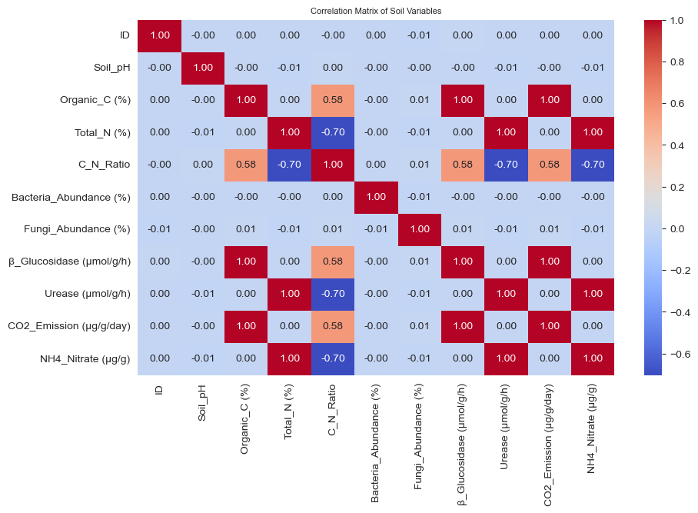
Dataset
Visualisation

Slide 10
Regression
Machine Learning for CO₂ Emission Prediction
Models Built:
Random Forest Regressor
Linear Regression – Best Model
XG Boost
Training & Testing: Pipelines applied with preprocessing included.
Evaluation Metrics: R², MAE, MAPE
Results:
Among the tested algorithms, Linear Regression achieved the best accuracy and generalization
Random Forest and XGBoost captured non-linear relationships in soil–microbe–CO₂ interactions
Insights : Feature importance showed microbial and enzyme activity are strong predictors.

Slide 11
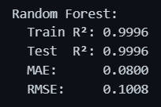
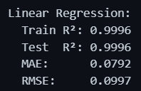
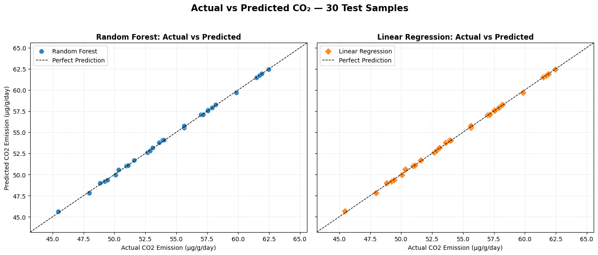
RESULTS

Slide 12
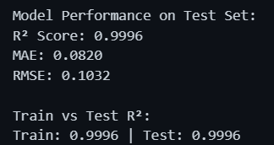
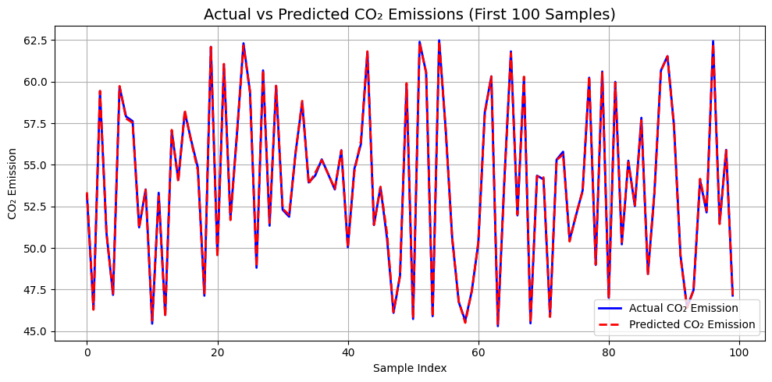
RESULTS
XG Boost

Slide 13
Carbon Degradation Classification in Soil Microbial Communities
Loads and Cleans Data: It reads the dataset file and cleans the data by converting categorical and range-based values into a numerical format suitable for machine learning.
Feature Engineering: It creates a new target variable called 'Functional_Role' based on the median value of the 'β_Glucosidase' column. This simplifies the prediction to a binary classification problem.
Model Training: It uses a Random Forest Classifier, gradient boosting classifier, Logistic Regression a machine learning algorithm. The data is split into a training set (to teach the model) and a testing set (to evaluate its performance).
Prediction and Evaluation: The trained model predicts the functional role for the entire dataset. Its performance is evaluated using metrics like accuracy and a classification report. A confusion matrix is also generated to visualize the model's prediction accuracy.
Saves Results: The script saves the trained model as .joblib file for future use.

Slide 14
Carbon Degradation Classification in Soil Microbial Communities
Enzymatic Activity (μmol/g/h) | Biological Meaning | Functional Prediction
High (Above Median) | The soil microbial community is actively producing large amounts of the enzyme, indicating a high demand and high rate of cellulose decomposition. | High Carbon Degradation Potential
Low (Below Median) | The production and presence of the enzyme are lower, indicating a slower rate of decomposition or less available substrate. | Low Carbon Degradation Potential
The classification target was created using the enzyme β-Glucosidase (μmol/g/h). β-Glucosidase is a rate-limiting enzyme in the decomposition of cellulose (plant matter) into simple sugars. Its activity level is a direct indicator of the soil's capacity for carbon cycling.
High Activity: Samples were labelled High Carbon Degradation, indicating a fast turnover rate.
Low Activity: Samples were labelled Low Carbon Degradation, indicating a slower turnover rate.

Slide 15
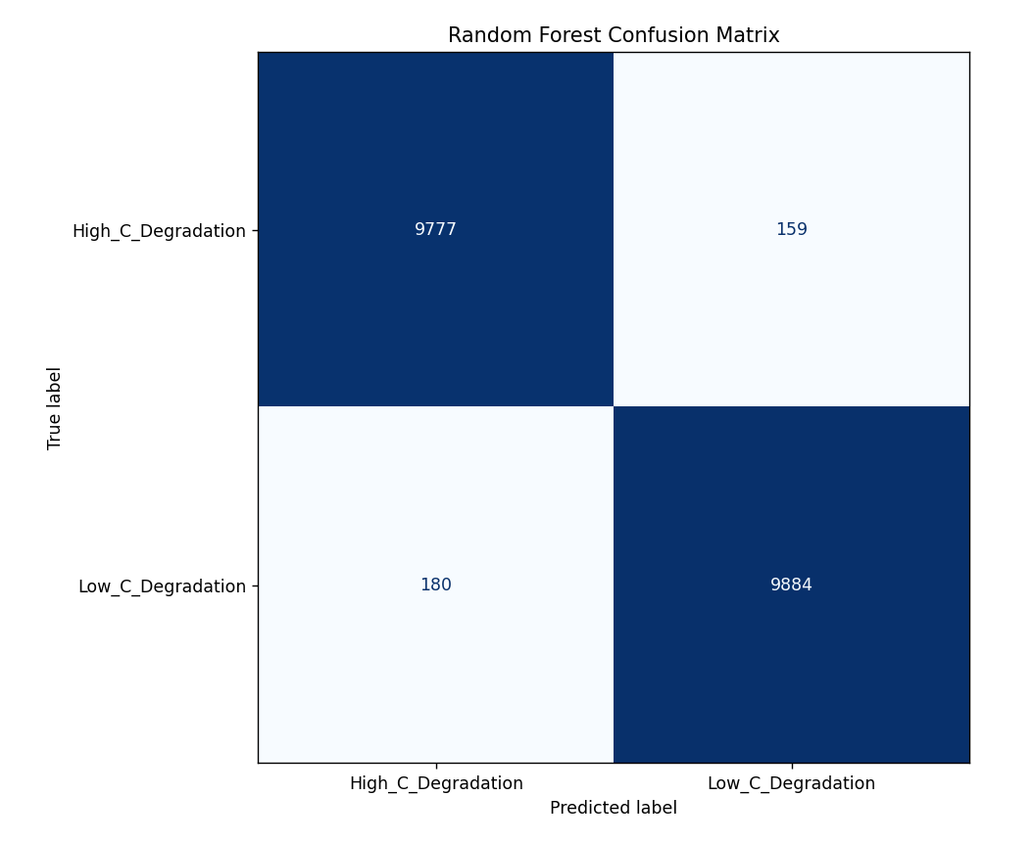
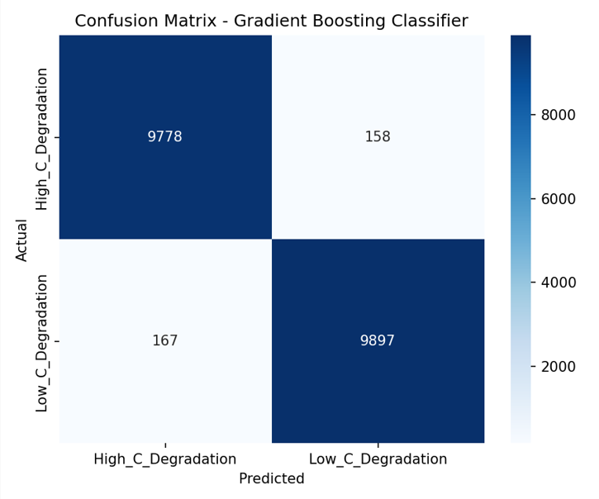
Random Forest Model
Gradient Boosting Model

Slide 16
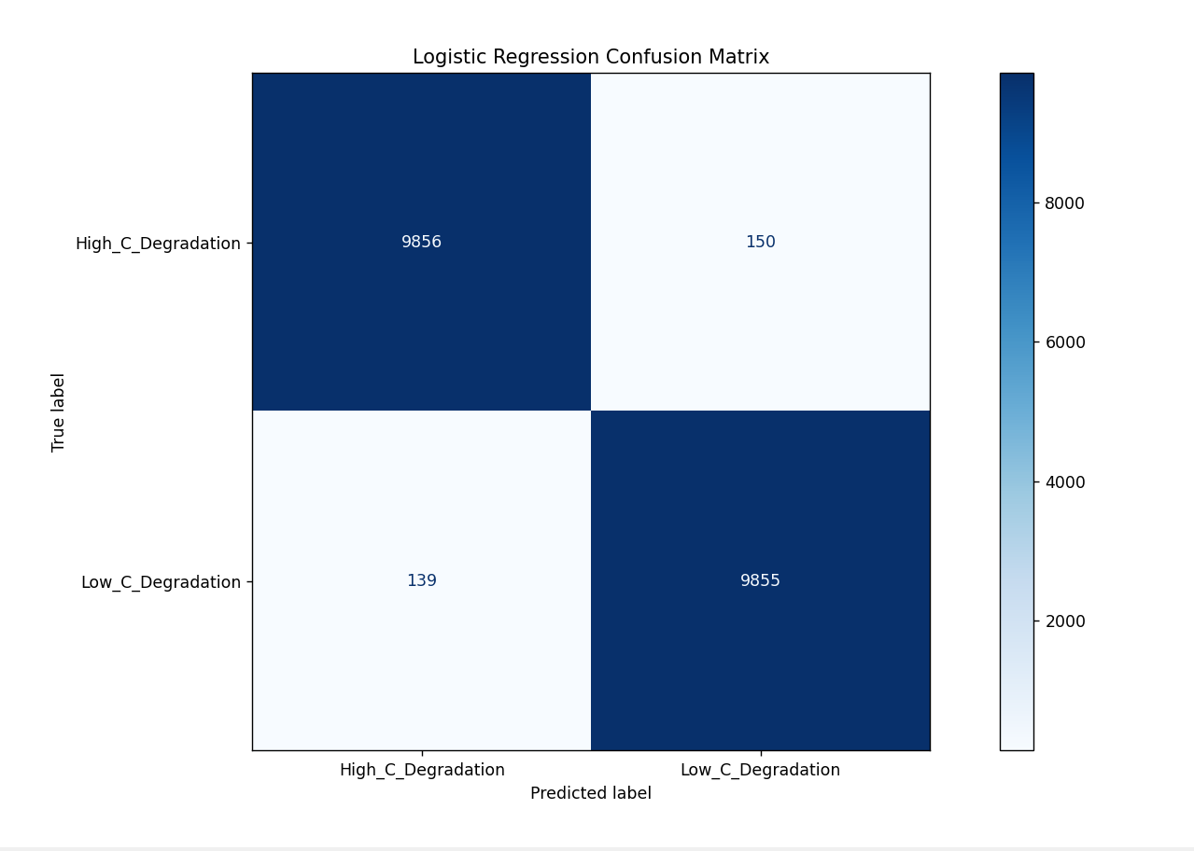
Logistic Regression Model

Slide 17
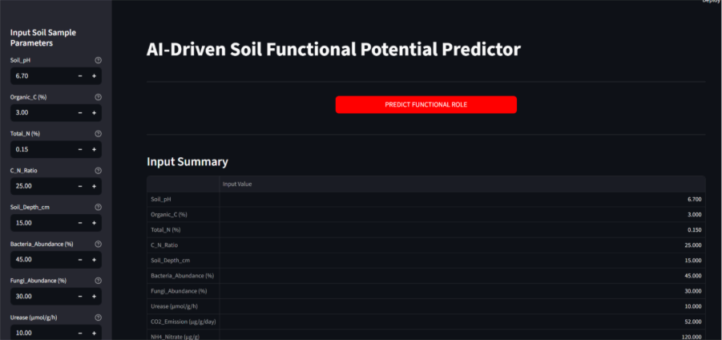
Streamlit Visualisation

Slide 18
Outcome
Reliable CO₂ Prediction Models: Built and tested XGBoost , Random Forest Regression and Linear Regression to predict CO₂ emission levels.
Performance Evaluation: Compared 3 models using metrics like R², RMSE, and MAE, showing how well each predicts co2_prediction.
Model Comparison: Random Forest handled non-linear relationships better, while Linear Regression provided a simpler baseline model.
Feature Contribution Analysis: Random Forest feature importance helped identify which microbial/soil factors most strongly influence CO₂ emissions.

Slide 19
Conclusion
This project develops high-accuracy machine learning models, including Linear Regression, Random Forest, and XGBoost, to predict soil CO₂ emissions , functional role prediction using soil microbe and chemical data. A user-friendly Streamlit web application was also built to make these predictions interactive and accessible. A significant next step would be to incorporate time-series data to model how functional roles change in response to environmental shifts, such as seasonal variations or different agricultural treatments. Furthermore, integrating other 'omics' data (e.g., metagenomics, metatranscriptomics, metaproteomics) would provide a more holistic understanding of the genetic potential and expressed functions of the microbes.

Slide 20
References :
[1] Handelsman, J., Rondon, M. R., Brady, S. F., Clardy, J., & Goodman, R. M. (1998). Molecular biological access to the chemistry of unknown soil microbes: a new frontier for natural products. Chemistry & biology, 5(10), R245-R249.
[2] Galanova, O. O., Mitkin, N. A., Danilova, A. A., Pavshintsev, V. V., Tsybizov, D. A., Zakharenko, A. M., Golokhvast, K. S., Grigoryeva, T. V., Markelova, M. I., & Vatlin, A. A. (2025). Assessment of Soil Health Through Metagenomic Analysis of Bacterial Diversity in Russian Black Soil. Microorganisms, 13(4), 854. https://doi.org/10.3390/microorganisms13040854
[3] Garg D, Patel N, Rawat A, Rosado AS. Cutting edge tools in the field of soil microbiology. Curr Res Microb Sci. 2024 Feb 21;6:100226. doi: 10.1016/j.crmicr.2024.100226. PMID: 38425506; PMCID: PMC10904168.
[4] Feng, G., Xie, T., Wang, X. et al. Metagenomic analysis of microbial community and function involved in cd-contaminated soil. BMC Microbiol 18, 11 (2018). https://doi.org/10.1186/s12866-018-1152-5
[5] Karthikeyan, S., Orellana, L. H., Johnston, E. R., Hatt, J. K., Löffler, F. E., Ayala-del-Río, H. L., ... & Konstantinidis, K. T. (2021). Metagenomic characterization of soil microbial communities in the Luquillo experimental forest (Puerto Rico) and implications for nitrogen cycling. Applied and Environmental Microbiology, 87(12), e00546-21.

Slide 21
Thank You !

